Slide 1
ANTICIPATING HEPATIC DISORDER THROUGH MACHINE LEARNING CLASSIFICATION TECHNIQUES
TEAM MEMBERS:
G SAI LAKSHMI 20091A05D2
M GOWTHAMI 20091A0547
U VENU GOPAL 21095A0516
P VIGNESH 21095A0518
UNDER THE GUIDANCE OF
Mrs . S. RUBIA PARVEEN M.Tech.
Assistant Professor, Department of CSE

Slide 2

Key Insights
Abstract
Introduction
Existing System
Problem Statement
Literature Survey
Methodology
Requirements
Modules
Implementation Process
Algorithm Description
Result
Conclusion
References

Slide 3
ABSTRACT
Liver Disease is the leading cause of global death that impacts the massive quantity of humans around the world. This disease diagnosis is very costly and complicated. Machine learning is a process designed to discover patterns in large datasets to enable decision making. It can perform supervised , unsupervised , and reinforcement learning. It focuses on using data The Indian Liver Patient Dataset (ILPD) is used in this study was obtained from the University of California, Irvine repository. We use it to review previously classified patient health records and predict future patient health records. The machine learning algorithms we use are Logistic Regression, K Nearest Neighbors, Support Vector Machine, Random Forest. The aim of this project is to use these machine learning techniques to achieve maximum accuracy in predicting liver disease. The final result is determined using the most accurate machine learning algorithm and a interface is created using Flask where the users can check whether they have liver disease or not.

Slide 4
INTRODUCTION
Liver is the second largest organ that is present in the upper right part of abdominal cavity and its functions are secretes bile and glycogen, synthesis serum protein lipids, detoxifies blood endogenous and exogenous substances such as toxins, drugs, alcohols and stores vitamin D, A, K, E and B12.
Liver disease is the swelling of the liver caused by toxic substances, bacteria or inherited disease that causes the liver to not function properly as it is essential for digestion and get rid of bacteria.
Patients with Liver disease have been continuously increasing because of excessive consumption of alcohol, inhale of harmful gases, intake of contaminated food, pickles and drugs.
The symptoms of liver disease difficult to detect early on since the organ works properly despite being partially destroyed. Patients survival rate will increase on early diagnosis liver problem.
This project targets to develop a mechanism in order to predict the liver disease in people.

Slide 5
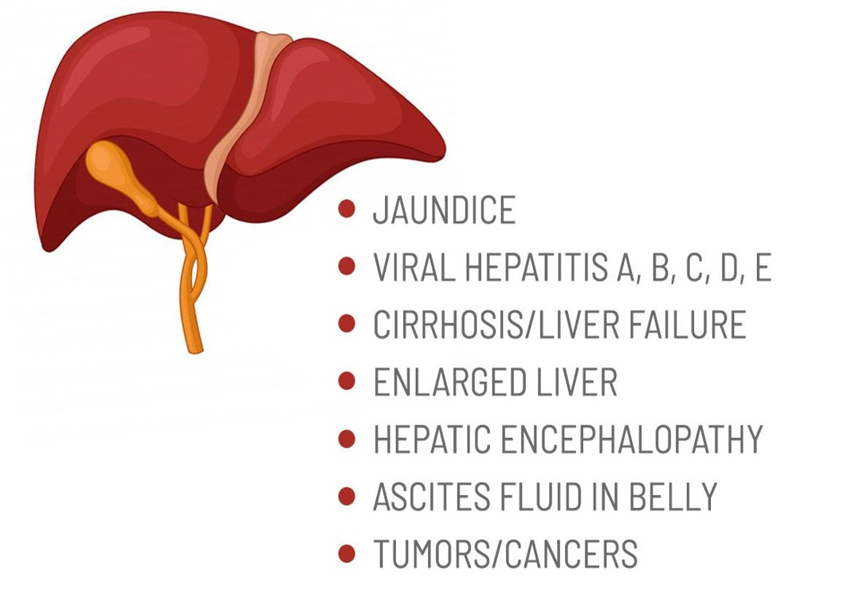
TYPES OF LIVER DISEASE
Notes:
Hepatocellular Carcinoma (HCC)

Slide 6
EXISTING SYSTEM
Viruses and alcohol cause fatal liver damage, including hepatitis, cirrhosis, tumors, and cancer. Liver diseases and cirrhosis are the main causes of death globally, making liver disease a major health concern. Over 2 million people die yearly from liver disease worldwide.
In 2010, one million died from cirrhosis and a million have liver cancer. The existing machine learning techniques are Light GB, CNN, KNN, and SVM.
Previously, machine learning algorithms solely focused on accuracy when predicting diseases of the liver. However, no user interface was created for this purpose.

Slide 7
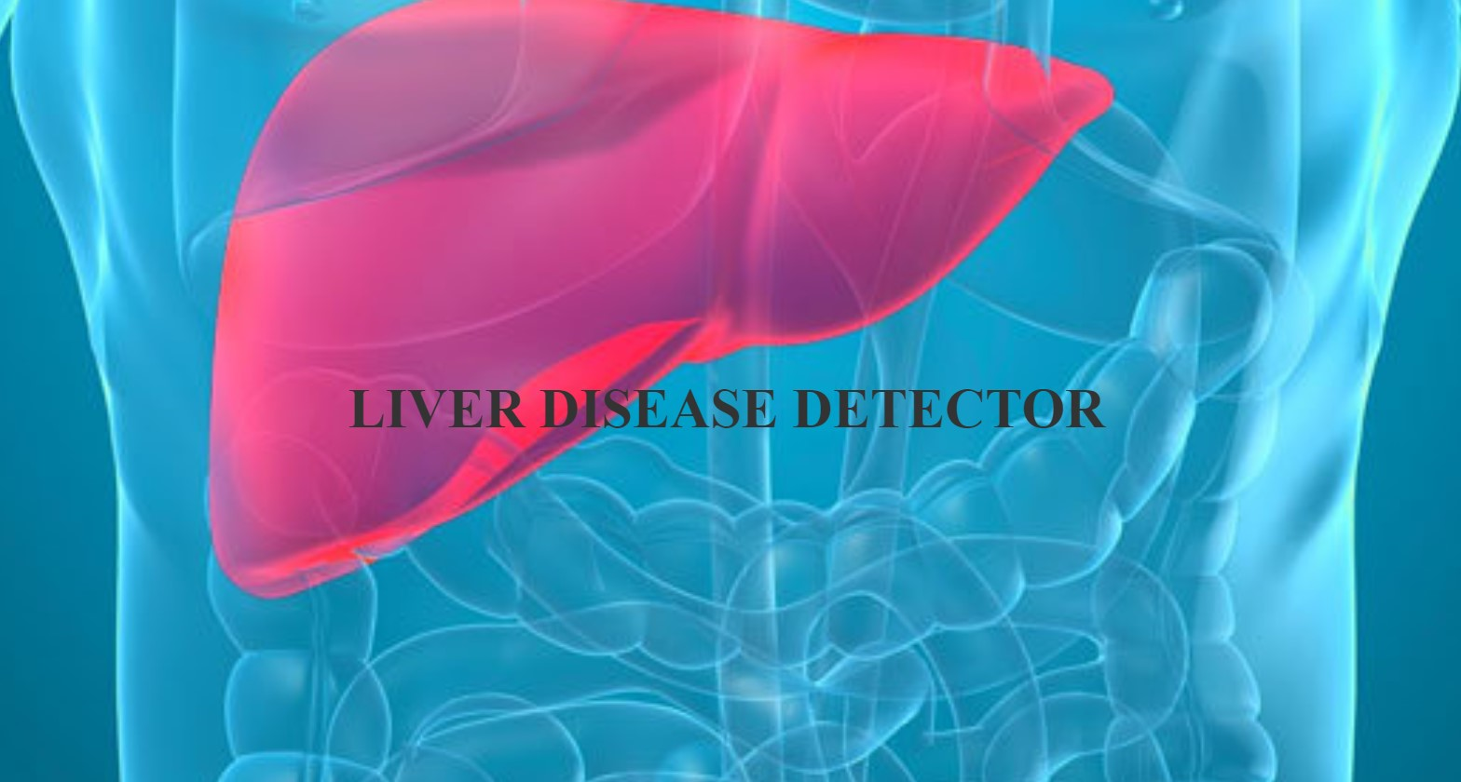
PROBLEM STATEMENT
We are building a model to predict the liver disease using supervised learning algorithm to increase accuracy and deploying this model as a web page.

Slide 8
LITERATURE SURVEY
Name of the paper | Year & month | Author Name | Algorithm/ Techniques Used | Advantages | Limitations
Liver Disease Prediction using Machine Learning Classification Techniques | 2022, April | Ketan Gupta, Nasmin Jiwani, Neda Afreen & Divyarani | Light GB | By use of Light GB algorithm we get the appropriate result and accuracy was 63%. | Disadvantage of Light GB method is it is narrow user based.
Liver Disease Prediction Using Machine Learning Classification | 2021, February | Jayakumar Sadhasivam, J.Senthil, R.M.Ganesh, N.Chellapan | Support Vector Machine. | Best accuracy obtained by the support vector machine algorithm was 68% | Further developments in the preprocessing were to be made.

Slide 9
LITERATURE SURVEY
Name of the paper | Year & month | Author Name | Algorithm/ Techniques Used | Advantages | Limitations
“Prediction of Liver Disease using Classification Algorithms | 2018, December | Thirunavukkarasu K, Ajay S. Singh, Md Irfan, Abhishek Chowdhury | Logistic Regression and K-Nearest Neighbor | Logistic Regression and K-Nearest Neighbor have the highest accuracy but logistic regression have the highest sensitivity. | Though K-Nearest Neighbor has highest accuracy its sensitivity is less than Logistic Regression.

Slide 10
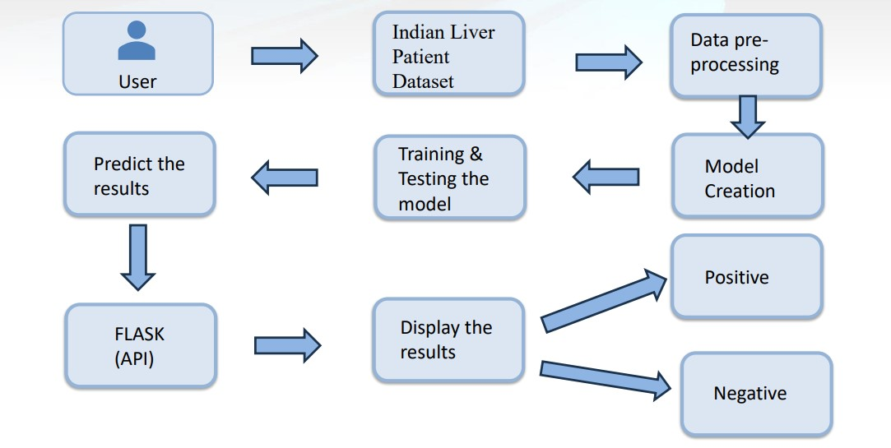
PROPOSED METHODOLOGY

Slide 11
HARDWARE & SOFTWARE REQUIREMENTS
HARDWARE REQUIREMENTS:
Processor : Intel Core
Hard Disk : 40 GB.
RAM : 8.00 GB
SOFTWARE REQUIREMENTS:
Operating System: Windows 10,11..etc
Coding Language: Python 3.0 and HTML.
Web Application Interface: Flask.

Slide 12
MODULES
Data collection and Pre-Processing
Model Training and Evaluation
Flask Application Development

Slide 13
MODULE SPLIT-UP
Data Collection and Preprocessing :
It is responsible for gathering relevant medical data such as patient demographics, clinical history, laboratory test results related to liver health.
It solves cleaning and preprocessing the collected data, which includes handling missing values, encoding categorical variables and scaling numeric features.
Data preprocessing ensures that the dataset is ready for use by machine learning algorithms, improving the accuracy and effectiveness of the predictive models.

Slide 14
MODULE SPLIT-UP
Model Training and Evaluation:
Trains machine learning models on the preprocessing dataset.
Selects appropriate machine learning algorithms such as Support Vector Machine, K Nearest Neighbouring, Logistic Regression, Random Forest and tuning their hyper parameters to optimize performance.
Model evaluation is performed using evaluation metrics such as accuracy, precision, recall to assess the performance of trained models and selects the best performing one for deployment.

Slide 15
MODULE SPLIT-UP
Flask Application Development:
Developing a web application using Flask a python web framework to provide a user-friendly interface for interacting with the predictive models.
Involves servers to handle user requests, such as submitting patient data for prediction and displaying the prediction results.
Flask application integrates the trained machine learning model allowing users to input their data and receive predictions for liver disease risk in real time.

Slide 16
MODULE SPLIT-UP
User: The user will register and login into the web application, enter his or her health records according to the attributes asked, and receive the predicted result of whether the user is positive for liver disease or not.
Web application: The web application will check whether the user who signed in to the page is an existing user or not. If not, it will redirect to the registration page. After registration, it will ask for user details and send them to the system. Later, when the system sends the prediction results, it will display them to the user.
System: Collects the user data from the web application, predicts the results, and sends them to the web application, where the data is displayed to the user.

Slide 17
IMPLEMENTATION PROCESS
1. USER:
1.1 DATA COLLECTION: The user collects the dataset of Indian Liver Patient Dataset(ILPD) to preprocess and train the model
1.2 ENTER THE ATTRIBUTES: The user enters the required attributes mentioned in the web page.
1.3 CHECKING VALUES: User checks whether all the values entered correctly or not.
1.4 PRESS SUBMIT: The user press this submit button to check the result whether they have liver disease or not.
1.5 VIEW RESULTS: Based the attributes entered a result will be displayed in the webpage.

Slide 18
IMPLEMENTATION PROCESS
2. WEB PAGE:
2.1 INTERFACE: create user interfaces for inputting the attributes and displaying the prediction results.
2.2 INPUTTING ATTRIBUTES: It setups for an user to enter the values in the input fields
2.3 SUBMIT: when submit button is pressed the result will be displayed
2.4 RESULTS: The web page displays the results whether the patient has liver disease or not.

Slide 19
IMPLEMENTATION PROCESS
3.SYSTEM:
3.1 PREPROCESSING: preprocess the data by cleaning and normalizing the values, removing null values, and preforming outliner detection and elimination.
3.2 FEATURE EXTRACTION: Perform the exploratory data analysis and transform the raw data into numerical features and know about the categorical features.
3.3 TRAIN TEST SPLIT: Split the dataset into training and testing sets to evaluate the performance of the trained model.
3.4 MODEL TRAINING AND EVALUATION: choosing machine learning algorithms such as logistic regression,Random forest,Naive Bayes etc and evaluate the trained model's performance on the testing set using appropriate metrics like accuracy, precision, recall, and F1 score.
3.5 MODEL SELECTION: Select the machine learning algorithm with best accuracy for prediction.

Slide 20
ALGORITHM DESCRIPTION
K Nearest Neighbour (KNN): It is a non-parametric algorithm used for both classification and regression tasks. It works by finding the K nearest data points in the training set to a given test point and classifying the test point based on the majority class of its neighbors. KNN does not make any assumptions about the underlying data distribution.
Logistic Regression (LR): It is a supervised learning algorithm used for binary classification problems. It models the relationship between the dependent variable and one or more independent variables by estimating the probabilities using a logistic function. The algorithm aims to find the best-fit line that separates the two classes.

Slide 21
ALGORITHM DESCRIPTION
Support Vector Machine(SVM): It is a supervised learning algorithm used for both classification and regression tasks. It aims to find the best hyper plane that separates the data points of different classes with the maximum margin. SVM can handle both linearly separable and non-linearly separable data by using different kernel functions.
Random Forest Classifier: It is an ensemble learning algorithm that combines multiple decision trees to make predictions. It works by creating a set of decision trees on different subsets of the training data and then averaging their predictions. Random Forest can handle both classification and regression tasks and is known for its ability to handle high-dimensional data and avoid over fitting.

Slide 22
REVIVAL OF PROPOSAL
Liver disease refers to an abnormality in the liver’s function, resulting in illness . The liver is responsible for many vital functions within the body, and if it becomes damaged or infected, the loss of these functions can have a significant impact on overall health. Hepatic disorder is another term used to describe liver disease . This umbrella term encompasses a range of possible complications that prevent the liver from performing its assigned roles. Even if only a quarter of the liver is still functioning and the rest is damaged, this organ’s efficiency will be greatly reduced. The liver is the biggest hard structure in the human build and is well thought-out as a gland because, amid its many roles, it creates and secretes bile. The liver is stood at the upright part of the abdomen and the rib cage shelters it. It has two core lobes that are thru with small lobules. The liver cells have two dissimilar bases of a blood source.

Slide 23
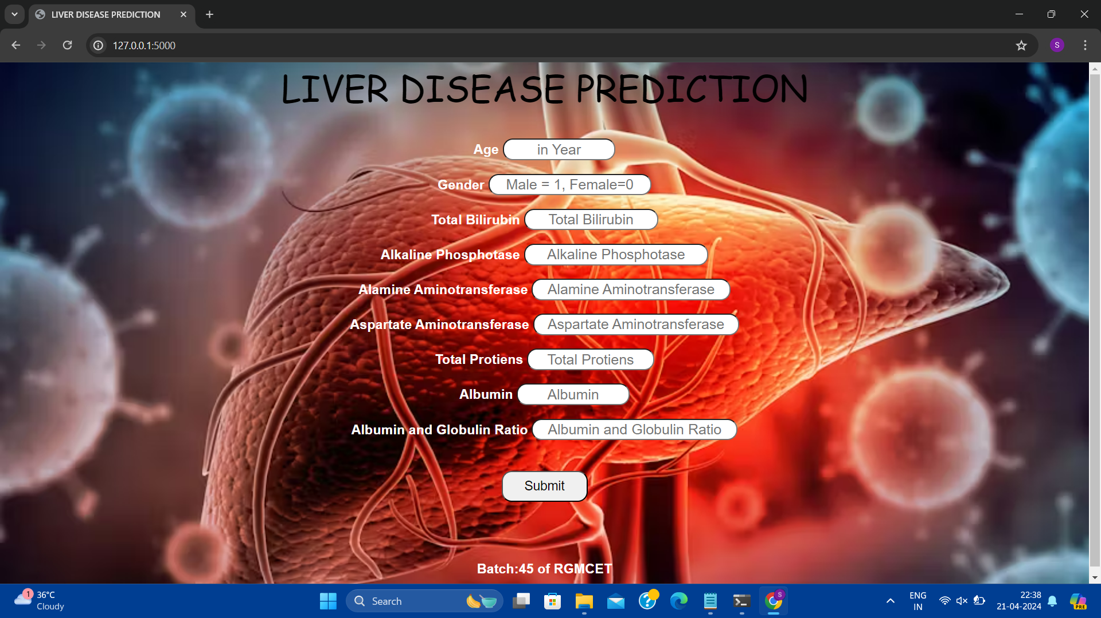
RESULT : Web Page

Slide 24
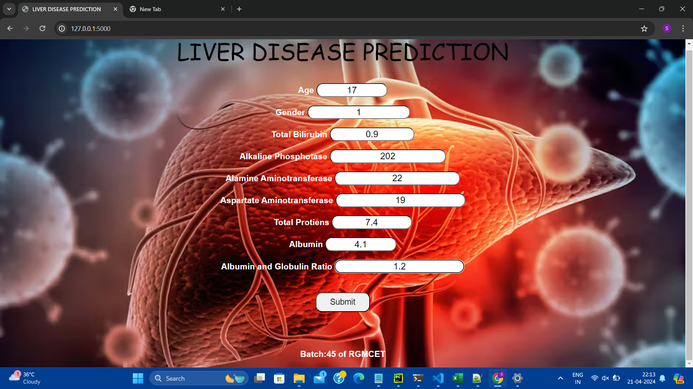
RESULT : Entering Values

Slide 25
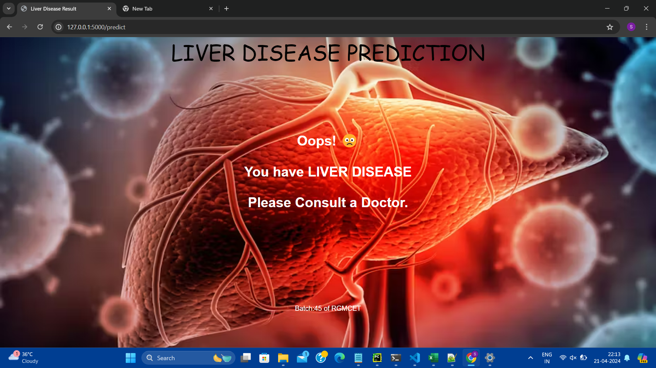
RESULT DISPLAY:

Slide 26

RESULT:Entering Values

Slide 27
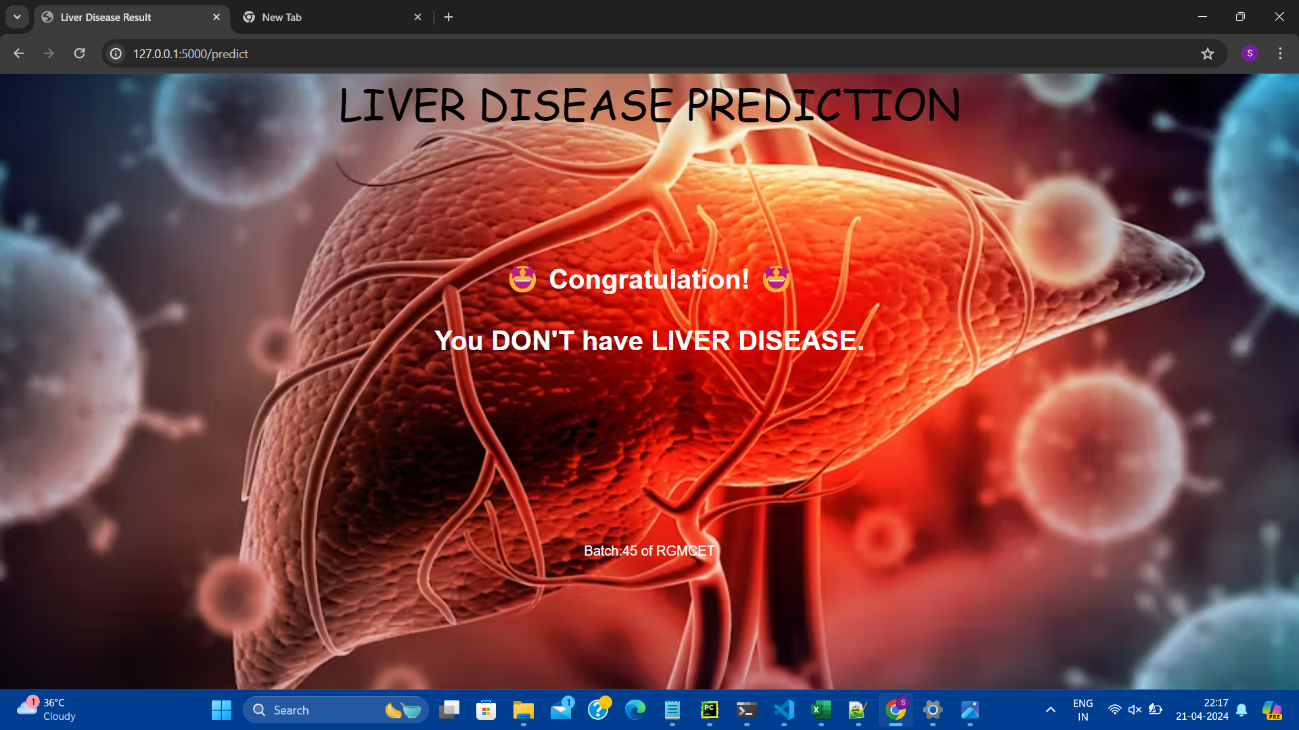
RESULT DISPLAY:

Slide 28
CONCLUSION
We conclude that through this project efficiency of the prediction is increased and accuracy of the prediction algorithms where we have used different algorithms to predict the accuracy of the disease is determined. Finally we created a web application through flask interface where the users can check whether they have liver disease or not.

Slide 29
REFERENCES
Ketan Gupta, Nasmin Jiwani, Neda Afreen & Divyarani D “Liver Disease Prediction using Machine learning Classification Techniques” in 11th IEEE International Conference on Communication Systems and Network Technologies.
Jayakumar Sadhasivam, J.Senthil, R.M.Ganesh, N.Chellapan “Liver Disease Prediction Using Machine Learning Classification” in https://www.webology.org/datacms/articles/20211222042439pmWEB18293.pdf.
Thirunavukkarasu K, Ajay S. Singh, Md Irfan, Abhishek Chowdhury “Prediction of Liver Disease using Classification Algorithms” in 2018 4th International Conference on Computing Communication and Automation (ICCCA).

Slide 30
THANK YOU

